Slide 1
AUTOMATION AND WORKERS Making the Canadian Income Tax System Fair Again
February 9, 2019
Jinyan Li, Arjin Choi and Cameron Smith

Slide 2
Outline
Automation and workers
Unequal taxation of workers worsening in the age of automation
Existential threat to the income tax system
Erosion of tax base
Erosion of equity: horizontally and vertically
Income tax was meant to be fair
Proposing a universal tax on all forms of earned income

Slide 3
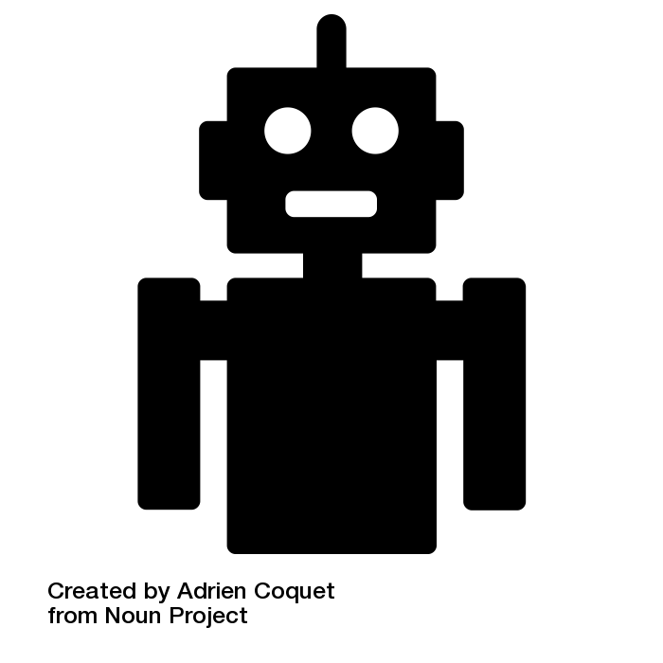
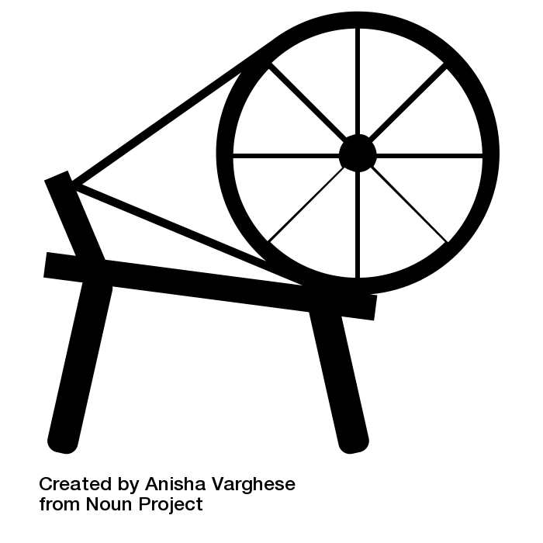
Robotic Automation
What?
How is it different from mechanical automation?
Transformative
Disruptive
FAST!!
Speed: 10X
Scale: 300X

Slide 4
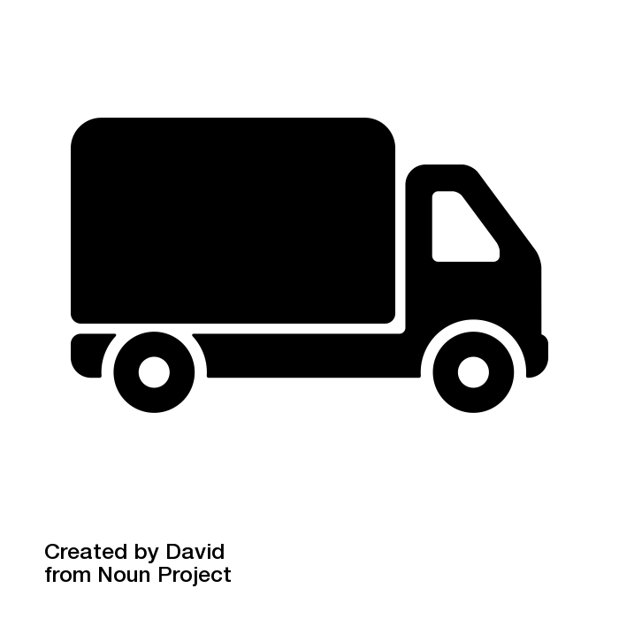
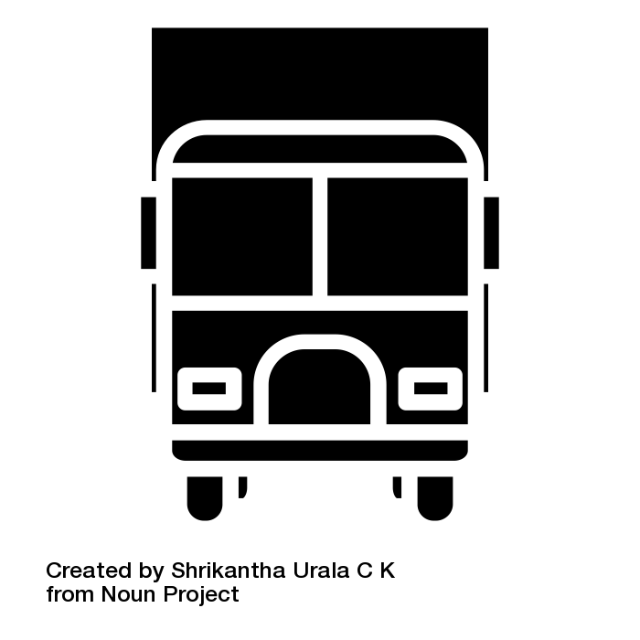
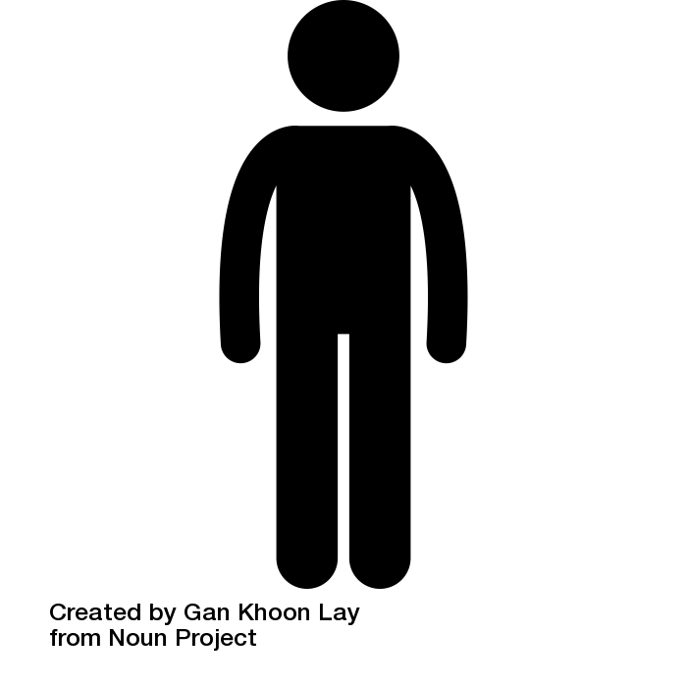
Automation and Workers
Overall increases in productivity?
Impact on workers:
Creation of new jobs
Eradication of existing jobs (e.g. Self driving trucks could cause unemployment of 280,000 truckers in Canada)
Employees → freelancers

Slide 5
Rise of “gigged workers”
45% of the Canadian workforce by 2020
50% of US millennials are already freelancing
Social and economic effect of this shift is largely unknown
Blurring line between employees, freelancers and entrepreneurs
This presents threats to the income tax system

Slide 6
Existing Unfair Tax Treatment of Workers
Type of Taxpayer | Employees | Self-employed | Private Corporations (incorporated workers)
 |  |  | General | Qualifying for SBD
Top Rate | 51.6% | 36% | 26.7% | 14.4%
Xco

Slide 7
Existing Unfairness Worsened by Automation
Employees taxed @51%
Gig/incorporated workers
taxed @14%

Slide 8
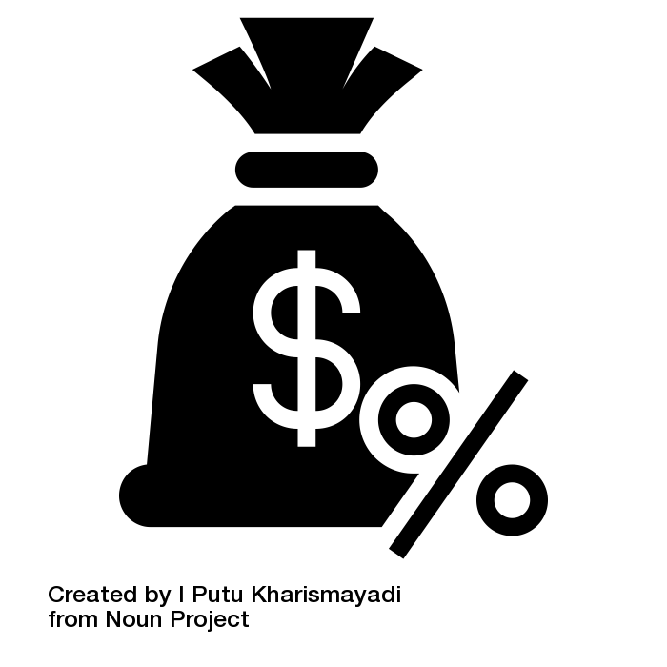
Existential Threat to the Income Tax (1)
Erosion of tax base
Declining % of total Canadian income earned through employment?
75% in 2010 to 72% in 2015

Slide 9
Existential Threat to the Income Tax (2)
Erosion of tax base
2) Leakage
Australian Treasury say: “gig-economy” workers have not been paying the right amount of tax”
Possible reasons:
a) tax awareness of the newly self-employed
b) outside the PAYG withholding system
Canada
Lower rate for incorporated workers
No withholding
No tax reporting
Xco

Slide 10
Existential Threat to the Income Tax (3)
Erosion of tax equity (based on ability to pay)
a) Horizontally
same amount of remuneration is taxed differently
b) Vertically
incorporated higher-income workers is taxed at lower effective rate than employees

Slide 11
How to save the Income Tax?
Replacing the existing system with a universal tax on earned income
All income of all workers is taxed the same!
“A buck is a buck is a buck”!

Slide 12
Proposed Universal Tax
a) Tax income of all workers in all settings the same (i.e. “earned income”)
b) Expand the withholding tax mechanism
Tax “earned income”
Expand witholding tax

Slide 13
Universal Tax: “Earned Income” (1)
Existing concept in the Income Tax Act (e.g., s.63)
Similar to “labour income” in the Dual Income System (Nordic countries)
Most challenge aspect is the income of incorporated workers
Expand the “personal services business” regime – taxing corporations at the top personal tax rate
Flow-through
Imputing corporate income to the shareholder/worker
Imputing a return to the corporation’s business by multiplying the value of the assets by an assumed rate of return on capital and profits exceeding the imputed return are deemed to be returns from labour
Imputing minimum wages to owner-employees and assigning the residue as a return from capital

Slide 14
Universal Tax: “Earned Income”(2)
Unveiling earned income disguised as capital
Dividends and capital gains earned by shareholder/workers in excess of return on capital
[Our proposal does not touch on progressive rates or taxation of capital per se]

Slide 15
Universal Tax: Extended Withholding tax
Employment income (1940s)
Non-resident service providers
(1980s-90s)
All workers’ income (age of automation)
Withholding

Slide 16
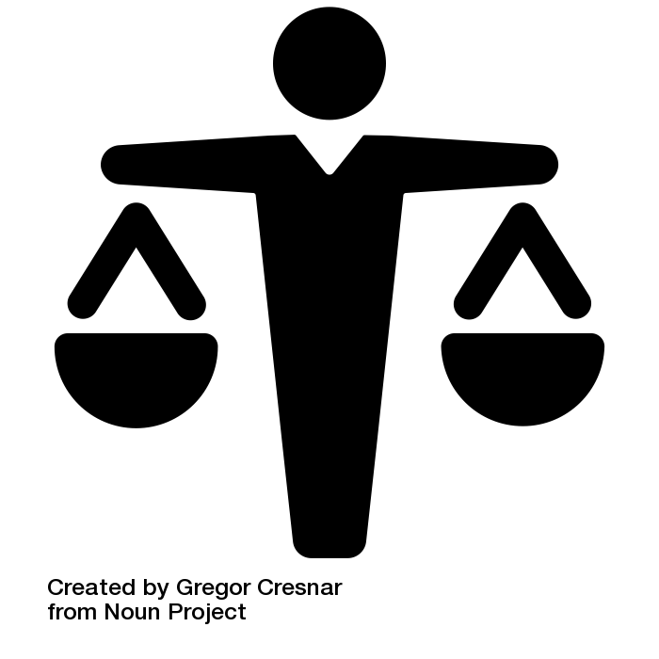
Making the Income Tax Fair Again?
1) Restoring the “ability to pay” principle
2) Restoring the democratic nature of the tax
Income tax is “a tax on ourselves”
Employee workers
Self-employed workers
Incorporated workers
3) Minimizing leakage through ”automated”/”digitized” withholding system

Slide 17
Comments are welcome!

