Slide 1
BEPS and the Emerging Global Approach to Taxing Multinational Enterprises
Jinyan Li
Jin Bao
Christina Li

Slide 2
Outline
Main argument:
A global approach to taxing MNEs for the 21st Century
BEPS and shifting international tax paradigm
The Value Creation Principle
Proposing a Global Profit Split Approach

Slide 3
Current Taxation of MNEs
MNE:
a enterprise carries on business in multiple countries through:
Local subsidiaries
Local branches (permanent establishments, PE)
Current taxation of MNE profits:
Domestic tax law of various countries
Local subsidiary or PE
Domestic source of income
Transfer pricing rules
Domestic laws “bridged” by bilateral tax treaties
Each country’s tax law “sees” part of the MNE profit (one-sided)

Slide 4
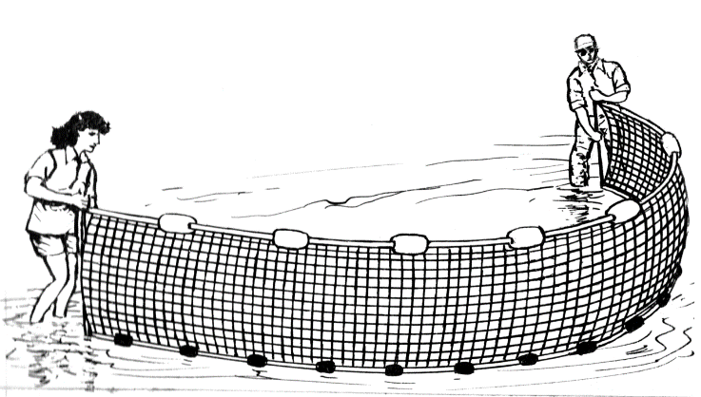
Base Erosion and Profit Shifting
MNEs can shift profit earned in production or market countries to a low-tax country through taking advantage of:
“Holes” in national tax laws (outdated rules)
“Holes” in tax treaties?
Avoiding PE under treaties
Treaty shopping
“Gaps”/differences in tax laws of different countries
Base “cyberization”
The fact that tax law is “accessory” to general law (such as corporate law and contracts);
Asymmetry in tax information
Tax Base

Slide 5
G20/OECD BEPS Project (2013)
loss of tax revenue
unfairness between MNEs and other taxpayers
Public confidence in tax system
BRICS: Have a say

Slide 6
BEPS Project
Goal:
To revise existing tax rules in order “to ensure that profits are
taxed where economic activities generating the profits are
performed and where value is created”
– “value creation principle”
Notes:
The project is NOT about “fundamental reform”
[unilateral and bilateral approach to taxing MNEs remain]
The Project is ambitious and comprehensive (15 action items)
BPES Package in 2015

Slide 7
BEPS Project & Emerging Global Approach
Global (multilateral)
Governance
Inclusive framework
MLI
CbCR

Slide 8
BEPS Project: Emerging “Global” View of MNEs
Examples:
Global value chain analysis in transfer pricing (Actions 8-10)
CbCR reporting (Master File)
EBITDA for interest deduction (firm-wide interest)

Slide 9
Value Creation Principle?
Emerged from the BEPS Project
Ambiguous
Meaning is unclear (what creates value and where value is created)
Not rules-based
Unclear roles
Functions as a source rule? → Used as a negative source rule
Relationship with Arm’s Length Principle?

Slide 10
Value Creation Principle as a Guiding Principle for the 21st Century?
Possibly “yes”
“ambiguity maybe its strength” in a globalizing world
Proposing a global profit split approach to taxing MNEs’ profit

Slide 11
Global Profit Split approach for the 21st Century
“Global profit” of a MNE
Allocate it to countries where value is created:
Routine profit
Residual profit based on a formulary (assets, payroll and sales)
Global profit
Residual
profit
assets
workforce
Routine profit
Existing rules
Sales

Slide 12
Alternative Proposals for Reforming International Taxation of MNEs
Sales-based formulary apportionment method
Single factor formula
Allocating residual profit for each unitary business
Destination-based residual profit method
Allocate residual profit to the market country, using transfer pricing rules
Multi-Factor Formulary Apportionment
CCCTB (consolidated common corporate tax base)
EU digital taxation proposal

Slide 13
Alternative Proposals for Reforming International Taxation of MNEs
4. Minimum Tax on Global Profits
GILTI + BEAT rules in the USA
5. Reverse the Residence-Source Paradigm
Residence taxation of active income
Source taxation of passive income

Slide 14
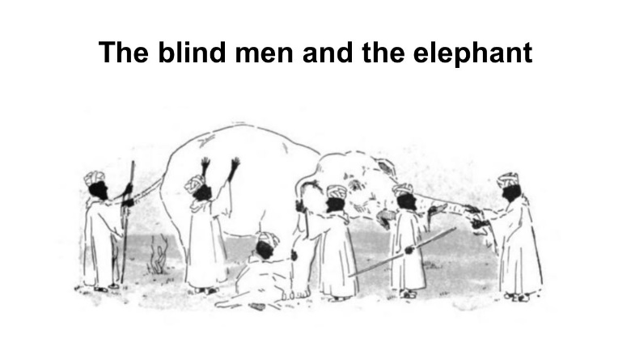
Making a Case for the Global Profit Split Approach
Value Creation Principle
Evolutionary Nature
Political Feasibility: appealing to
Production countries
Market countries
DEMPE countries
Technical Viability
Not easy, but
experience in Canada and US
CCCTB in EU
CbCR reporting
MLI
The elephant is the GLOBAL profit of MNEs

