Slide 1
The Future of the Progressive Personal Income Tax: How High Can It Go?
Kevin Milligan
Vancouver School of Economics
University of British Columbia

Slide 2
How High Can It Go?

Slide 3
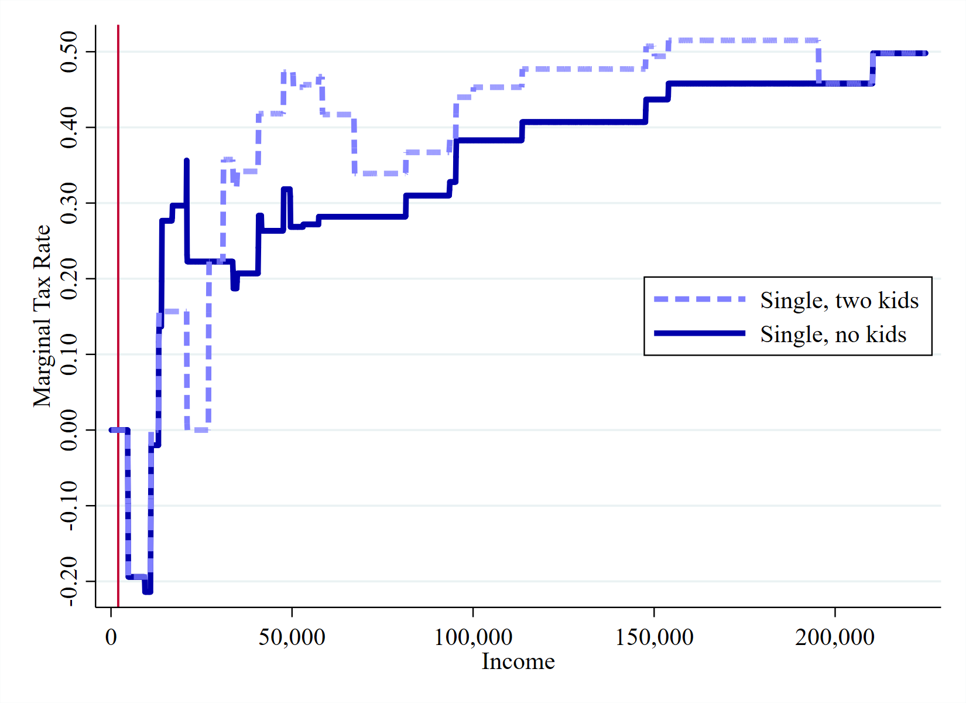
British Columbia
2019 tax year:
Marginal Effective Tax Rate on Earned Income

Slide 4
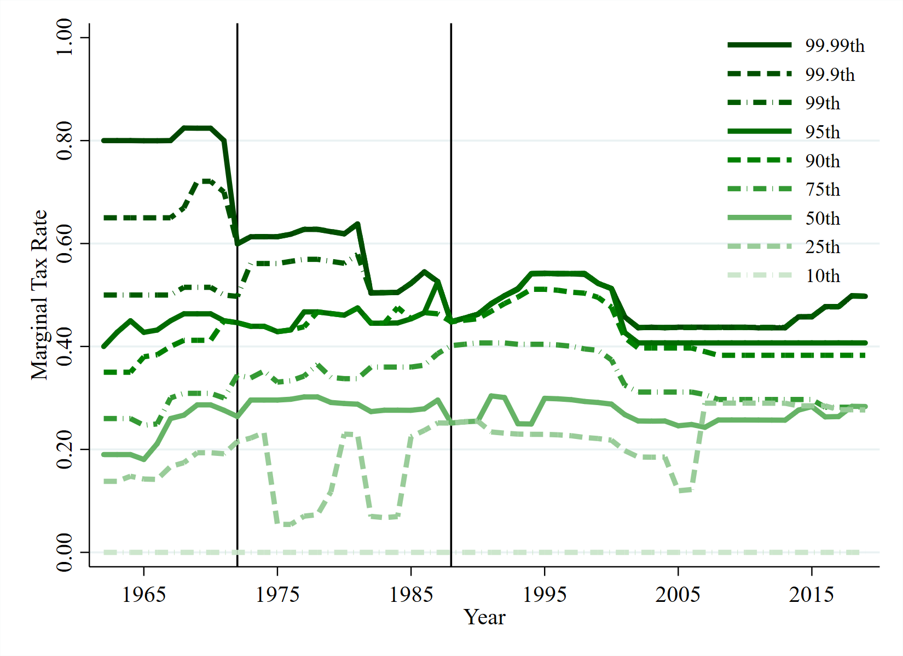
Marginal Tax Rate:
1962-2019 by Income Percentile

Slide 5
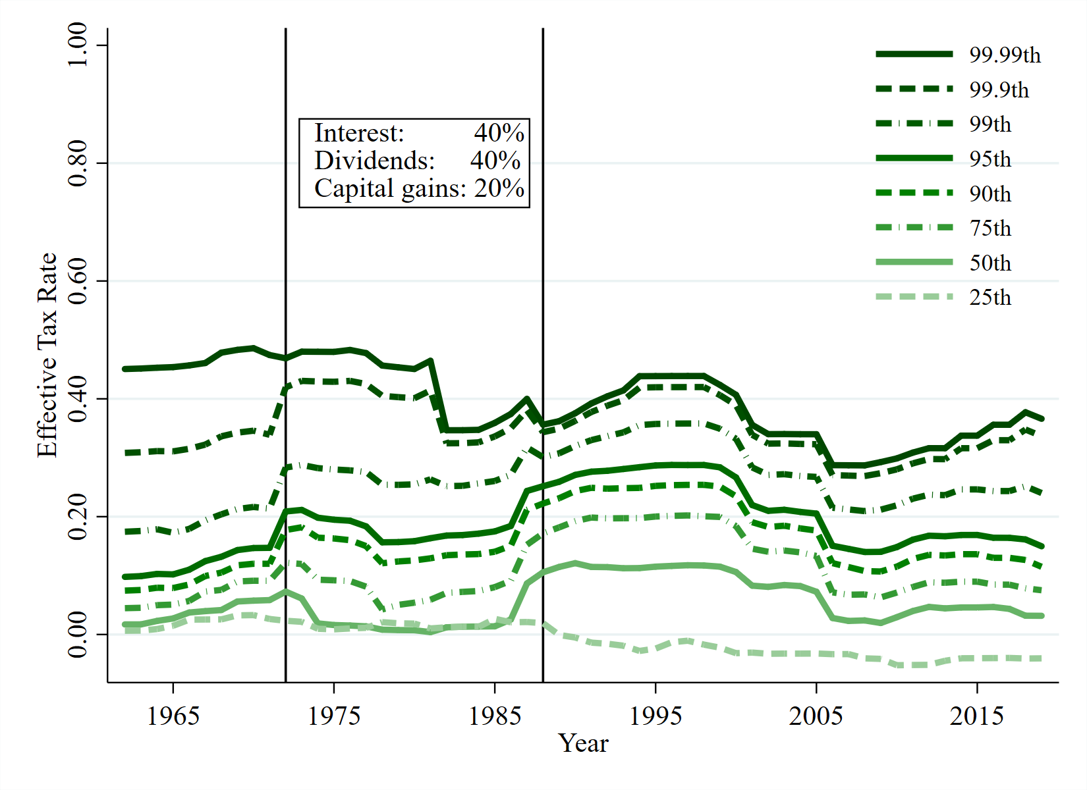
Effective Tax Rate:
1962 to 2019 by Income Percentile

Slide 6
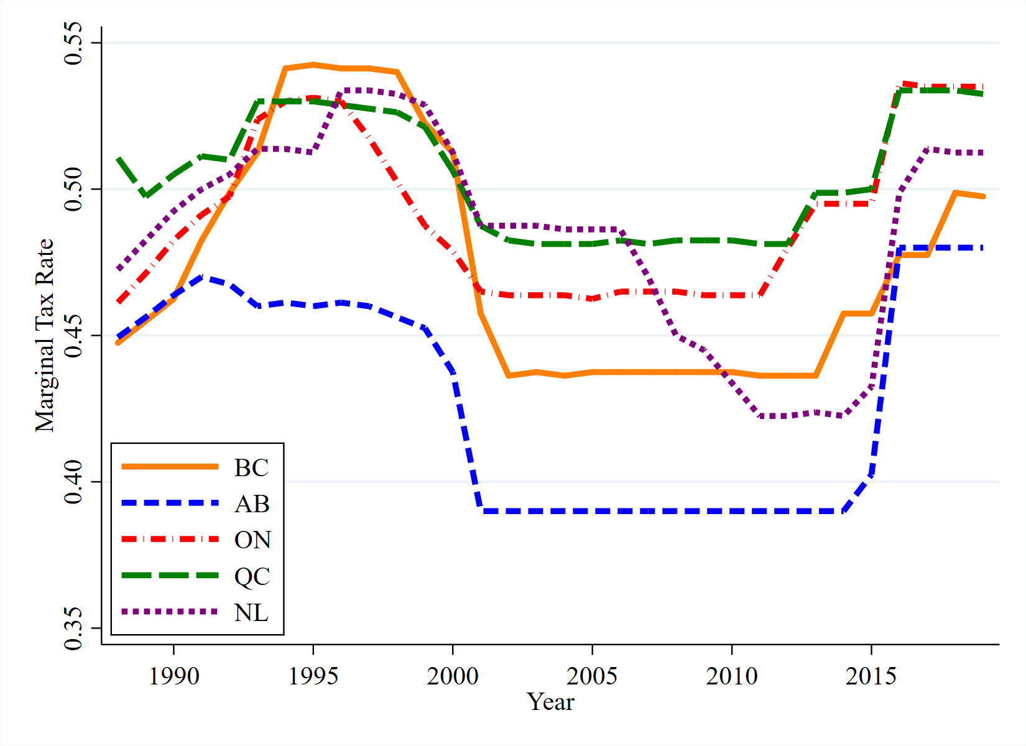
Selected Provinces 1988-2019:
Top Tax Rate on Earned Income

Slide 7
Top Personal Income Tax Rate:
OECD, 2017

Slide 9
Diamond-Saez:
Elasticity of taxable income.
Pick upper bound to maximize revenue.
Anchor for progressivity.

Slide 10
Criticisms:
Feldstein: citizens not ATMs.
Lockwood, Nathanson, Weyl: high earners yield negative externalities.
Saez and Zucman: high wealth distorts politics.
Piketty, Saez, Stantcheva: low tax distorts CEO wages.
Diamond-Saez:
Elasticity of taxable income.
Pick upper bound to maximize revenue.
Anchor for progressivity

Slide 11
Applying Diamond-Saez to Canada
Real Responses:
Labour supply
Mobility
Innovation

Slide 12
Applying Diamond-Saez to Canada
Real Responses:
Labour supply
Mobility
Innovation
Avoidance Responses:
Provincial shifting
CCPC shifting
International shifting

Slide 13
Lessons for Policy
For advocates of higher taxes:
Think about ETI, legislation, and enforcement.
Need details and serious plans.
For the skeptics
Don’t just shrug at tax avoidance.

Slide 14
The Future of the Progressive Personal Income Tax: How High Can It Go?
Kevin Milligan
Vancouver School of Economics
University of British Columbia

