Slide 1
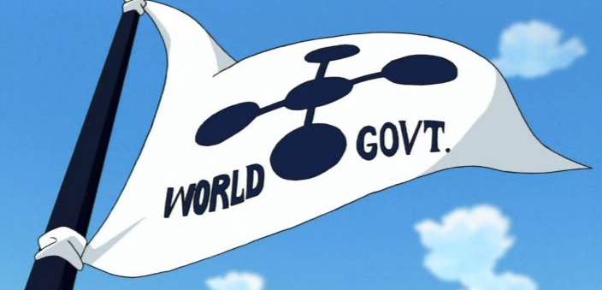
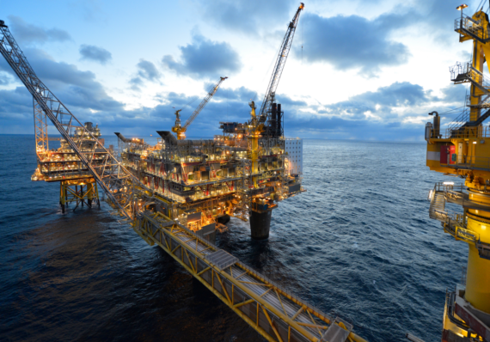
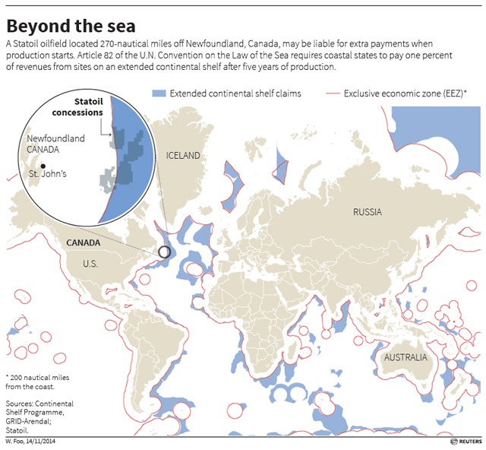
Extranational Taxation:
Canada and UNCLOS Art. 82
Re-imagining Tax for the 21st Century:
Inspired by the Scholarship of Tim Edgar
Toronto 8-9 Feb 2019
Micah Burch
Sydney Law School

Slide 3
What is Canada?

Slide 4
Article 82

Slide 5
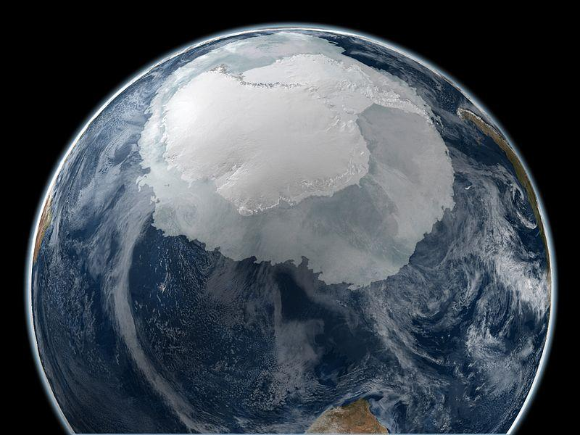
Extranational Places
Antarctica (“interest of all mankind”)
Space (“province of all mankind”)
Oceans and Seabed (“common heritage of mankind”)

Slide 6
Common Heritage of Mankind
Prohibition of sovereignty
Use for peaceful purposes
Shared management
Conservation
Equitable sharing of benefits of exploitation

Slide 7
Global EEZs

Slide 8
Global ECS areas

Slide 10
Article 82
Payments and contributions with respect to the exploitation of the continental shelf beyond 200 nautical miles.
1. The coastal State shall make payments or contributions in kind in respect of the exploitation of the non-living resources of the continental shelf beyond 200 nautical miles from the baselines from which the breadth of the territorial sea is measured.
2. The payments and contributions shall be made annually with respect to all production at a site after the first five years of production at that site. For the sixth year, the rate of payment or contribution shall be 1 per cent of the value or volume of production at the site. The rate shall increase by 1 per cent for each subsequent year until the twelfth year and shall remain at 7 per cent thereafter. Production does not include resources used in connection with exploitation.
3. A developing State which is a net importer of a mineral resource produced from its continental shelf is exempt from making such payments or contributions in respect of that mineral resource.
4. The payments or contributions shall be made through the [International Seabed] Authority, which shall distribute them to States Parties to this Convention, on the basis of equitable sharing criteria, taking into account the interests and needs of developing States, particularly the least developed and the land-locked among them.”

