Slide 1
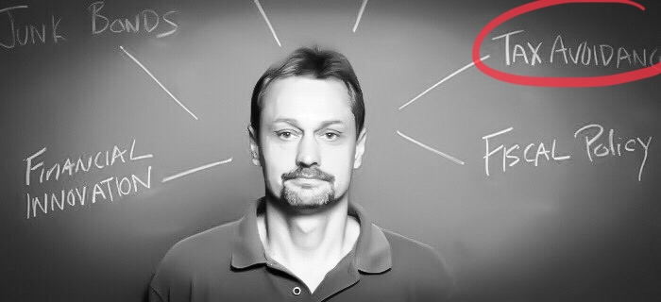

Slide 2
GAAR in Action :
Judicial Attributes and Transactions Types
Thaddeus Hwong, for a collaborative project with Tim Edgar and Jinyan Li
Made possible by funding support provided by the Canadian Tax Foundation

Slide 8
