Slide 1
Ahead by a Century
Tim Edgar, Machine-Learning,
and the Future of Tax Avoidance
Benjamin Alarie
February 9, 2019

Slide 3
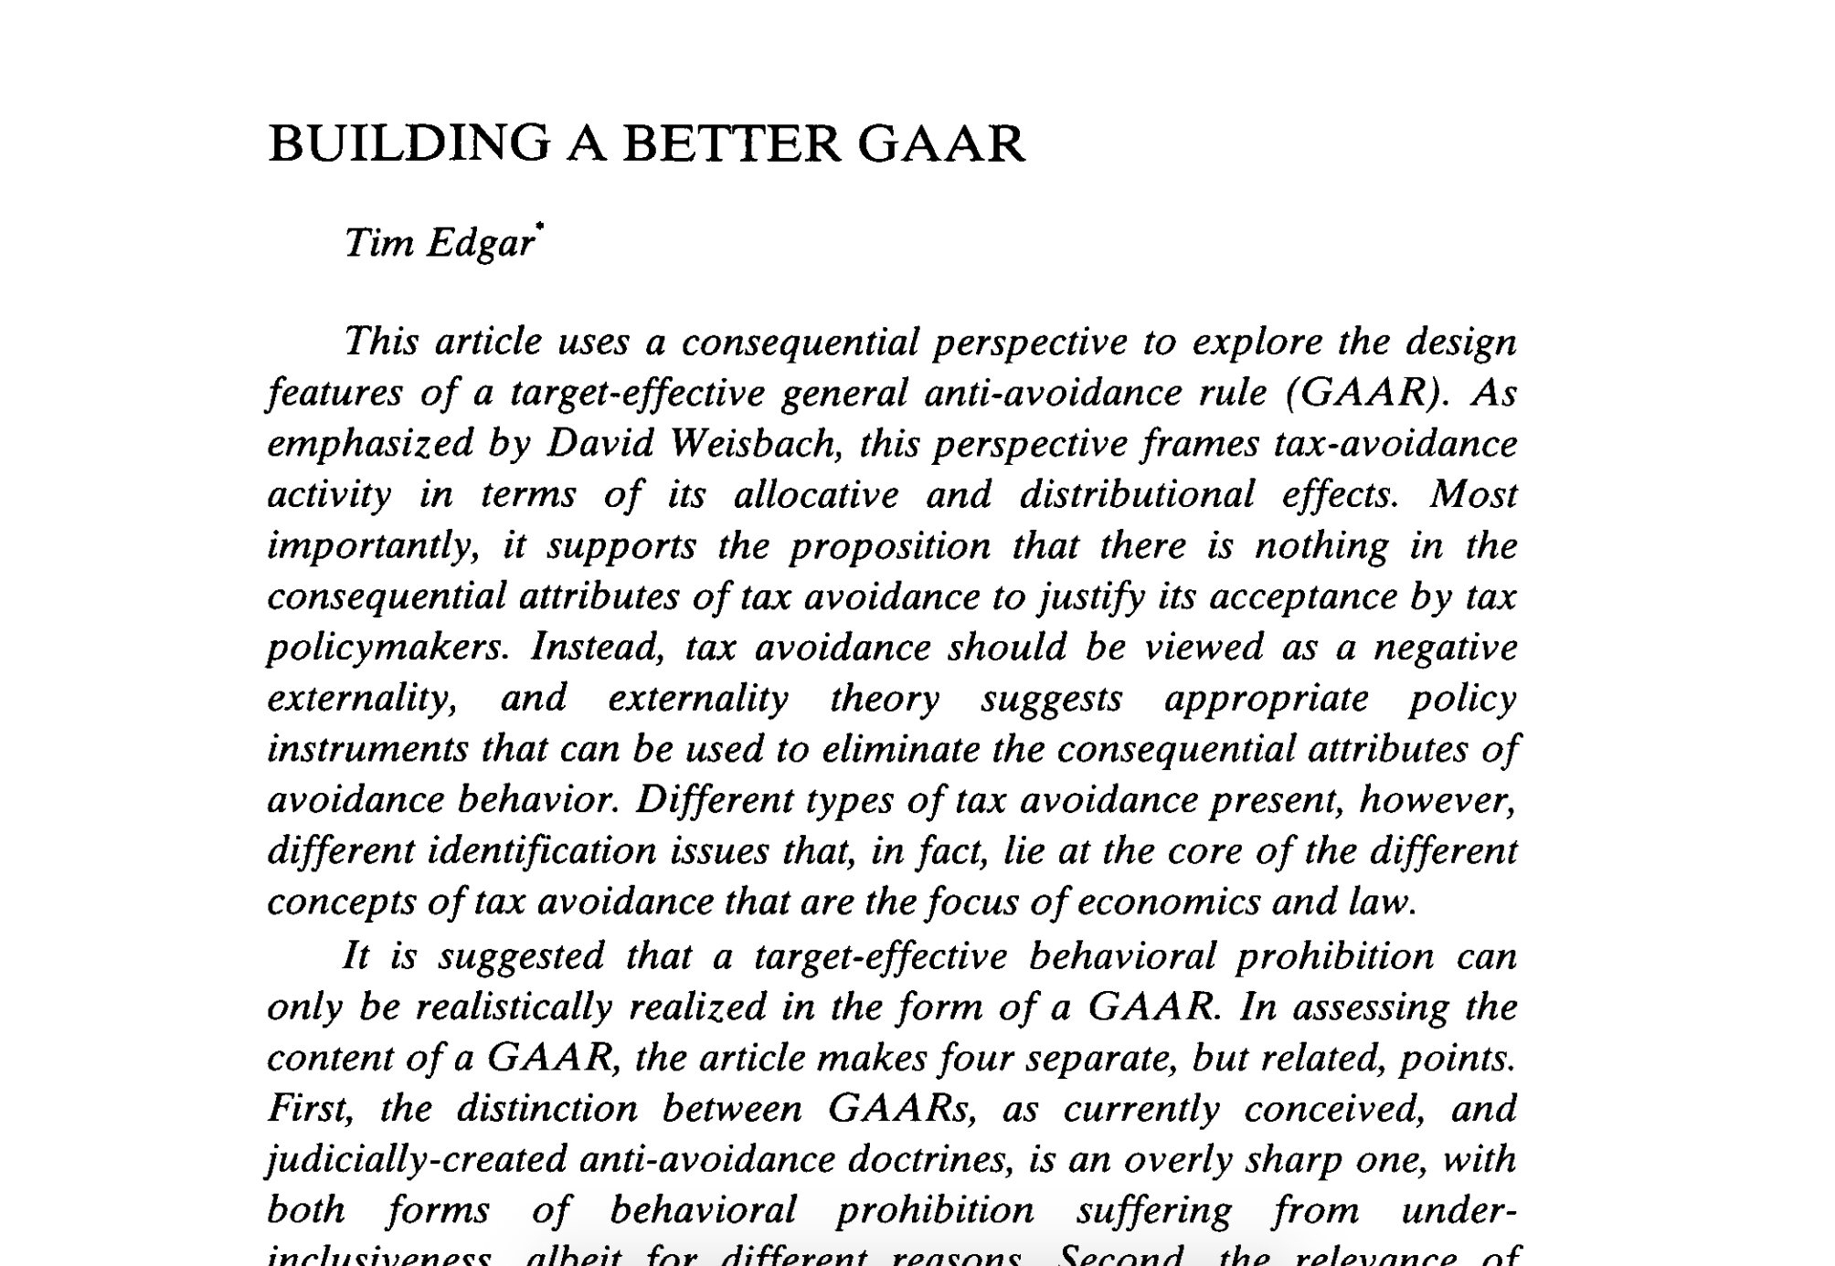

Slide 4
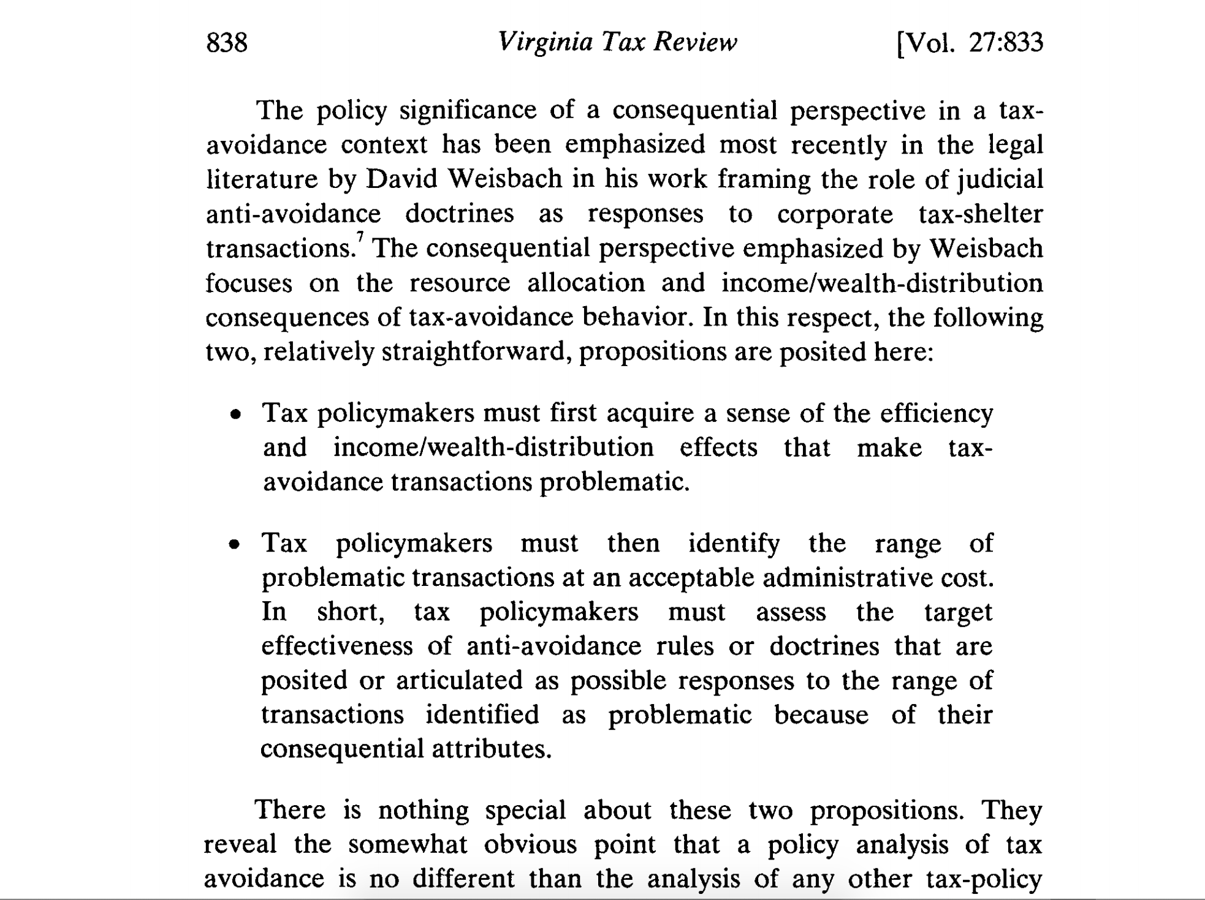

Slide 5
Challenging observations for building a better GAAR
Tax law and policymaking happens in the real world, with a full cast of real world citizens, real world policymakers, and real world legislators. We do not currently have an all-knowing, benevolent dictator setting the terms of tax law.
Because we do not have an all-knowing, benevolent dictator currently setting tax law, it is not the case that tax policymakers and legislators understand completely the efficiency and distributional consequences associated with our tax system(s).
There is no current way for tax policymakers to identify the range of problematic transactions at an acceptable administrative cost.

Slide 6
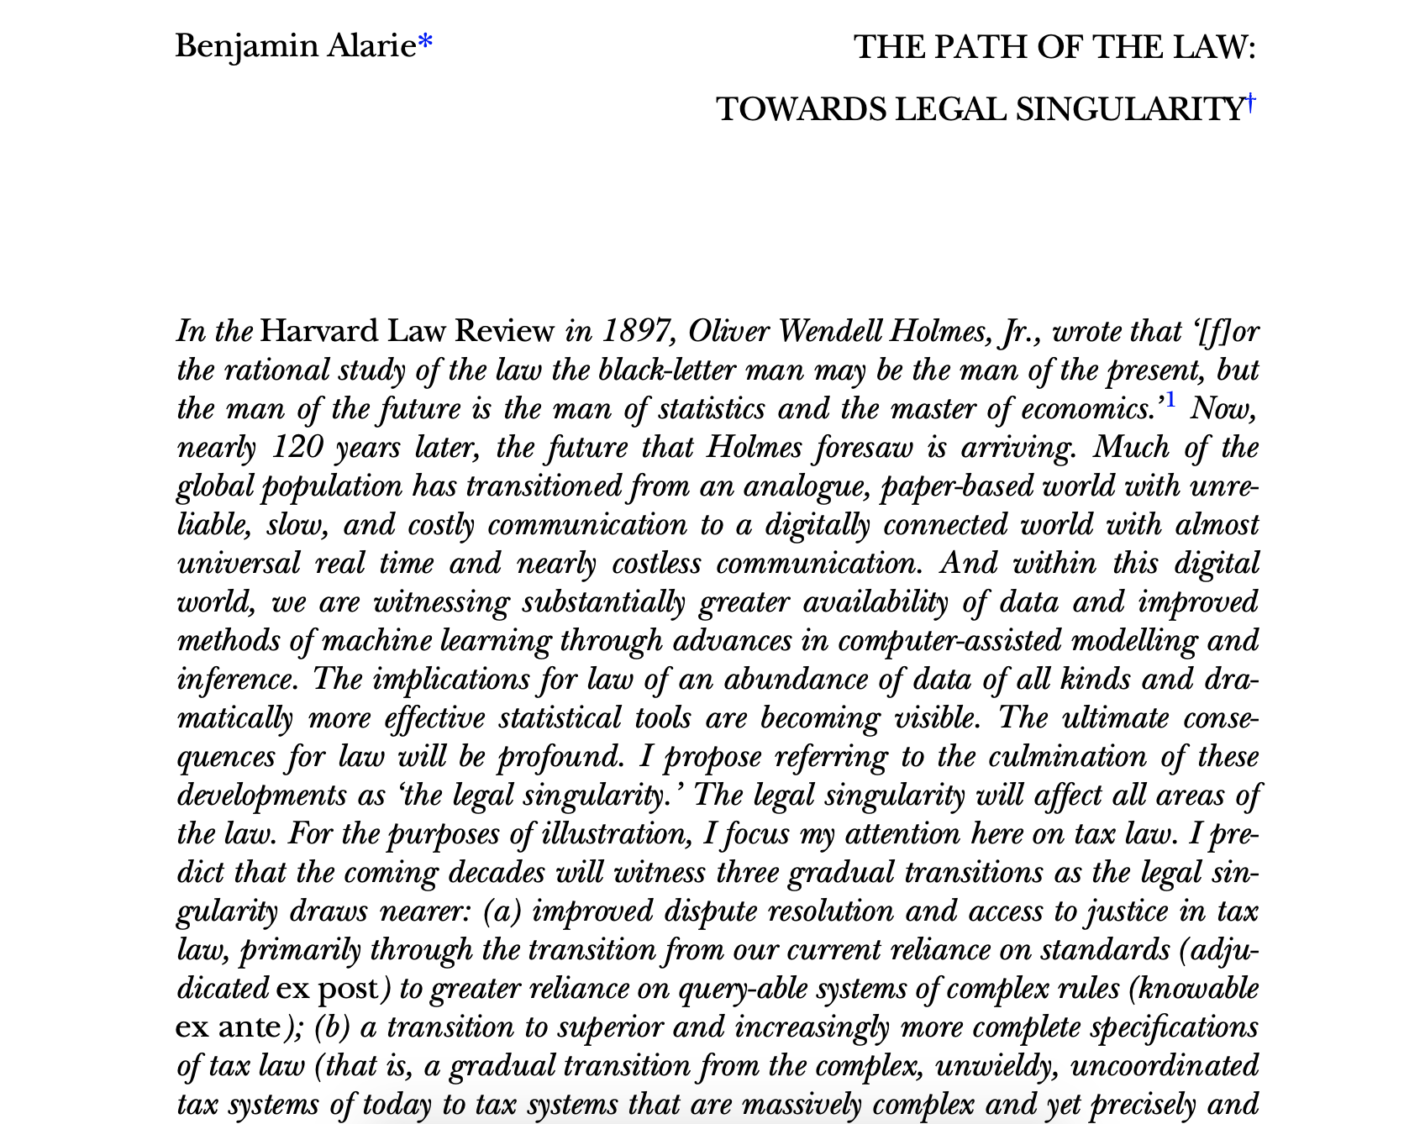
Machine learning will meet each of these three challenges—eventually

Slide 8
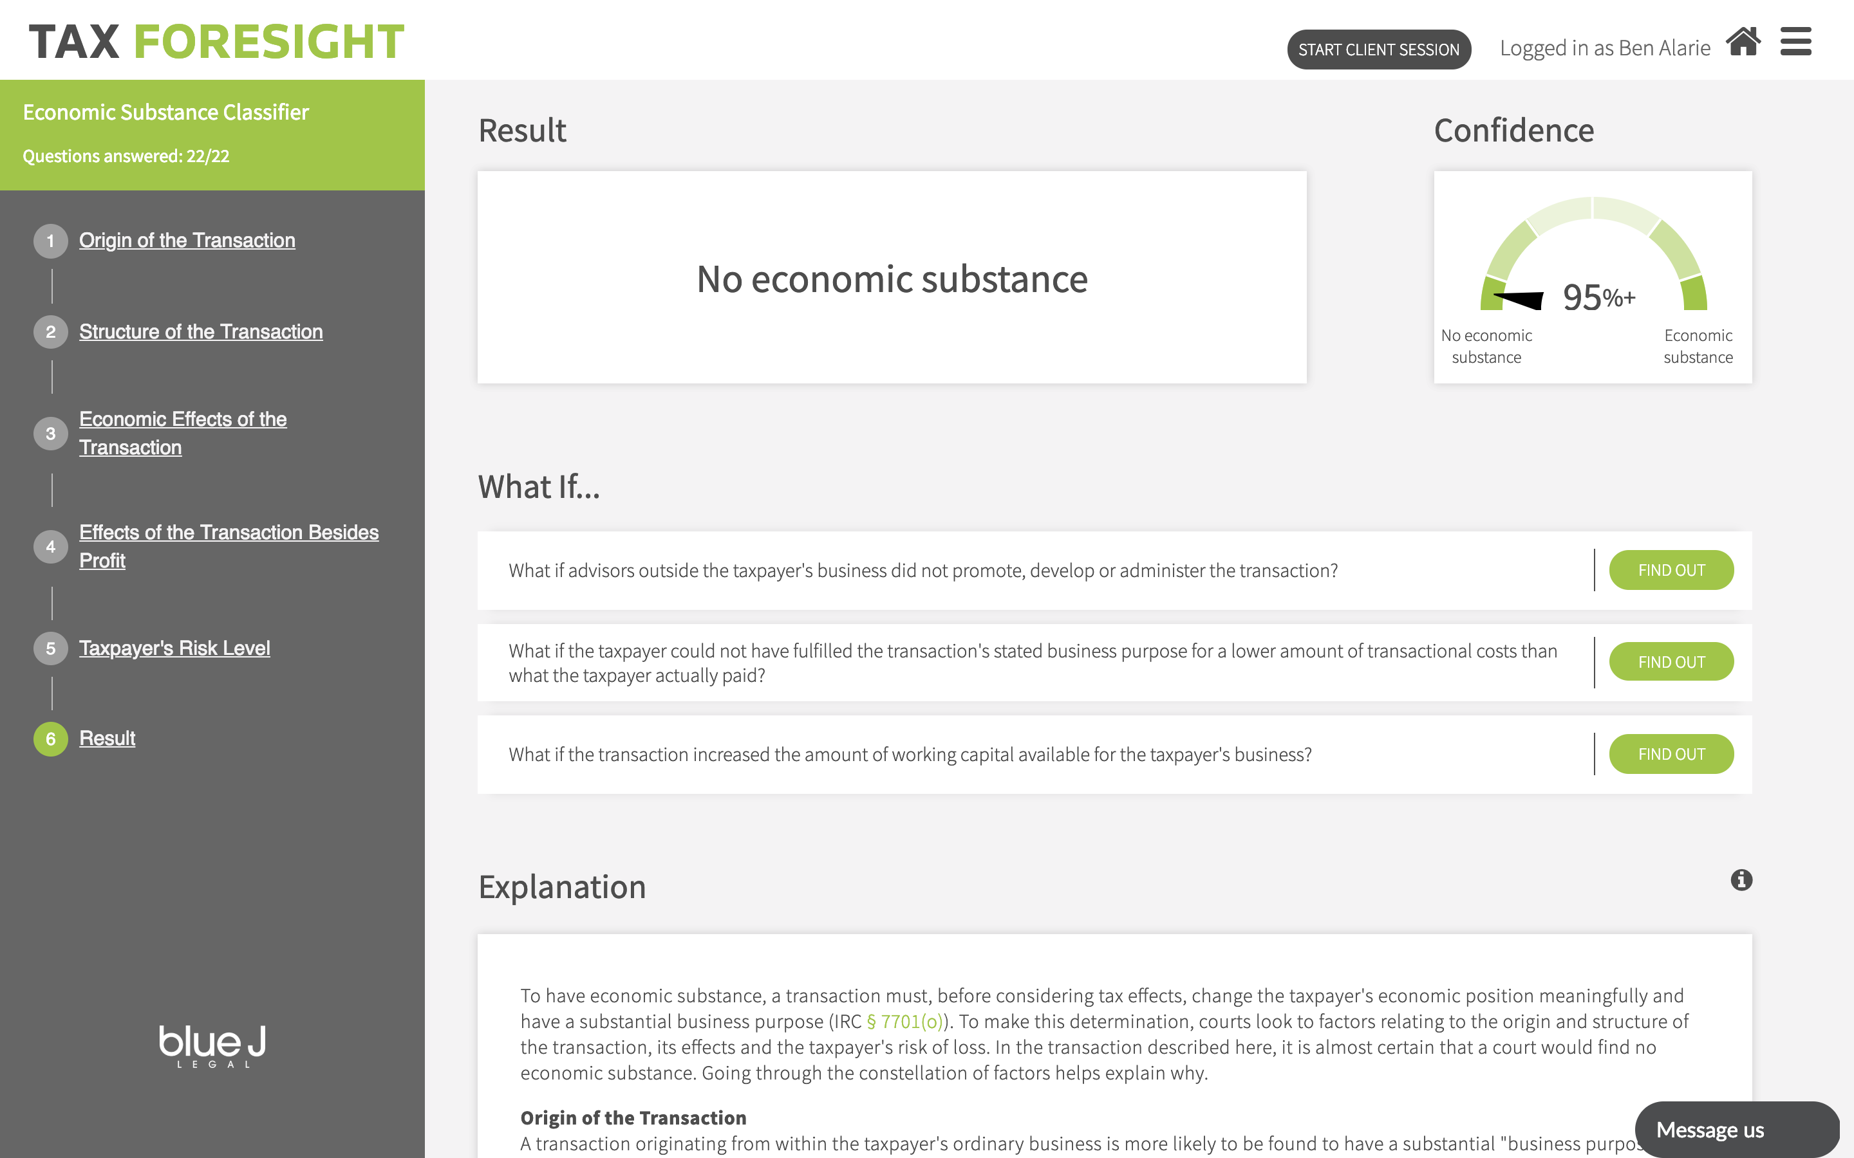

Slide 9
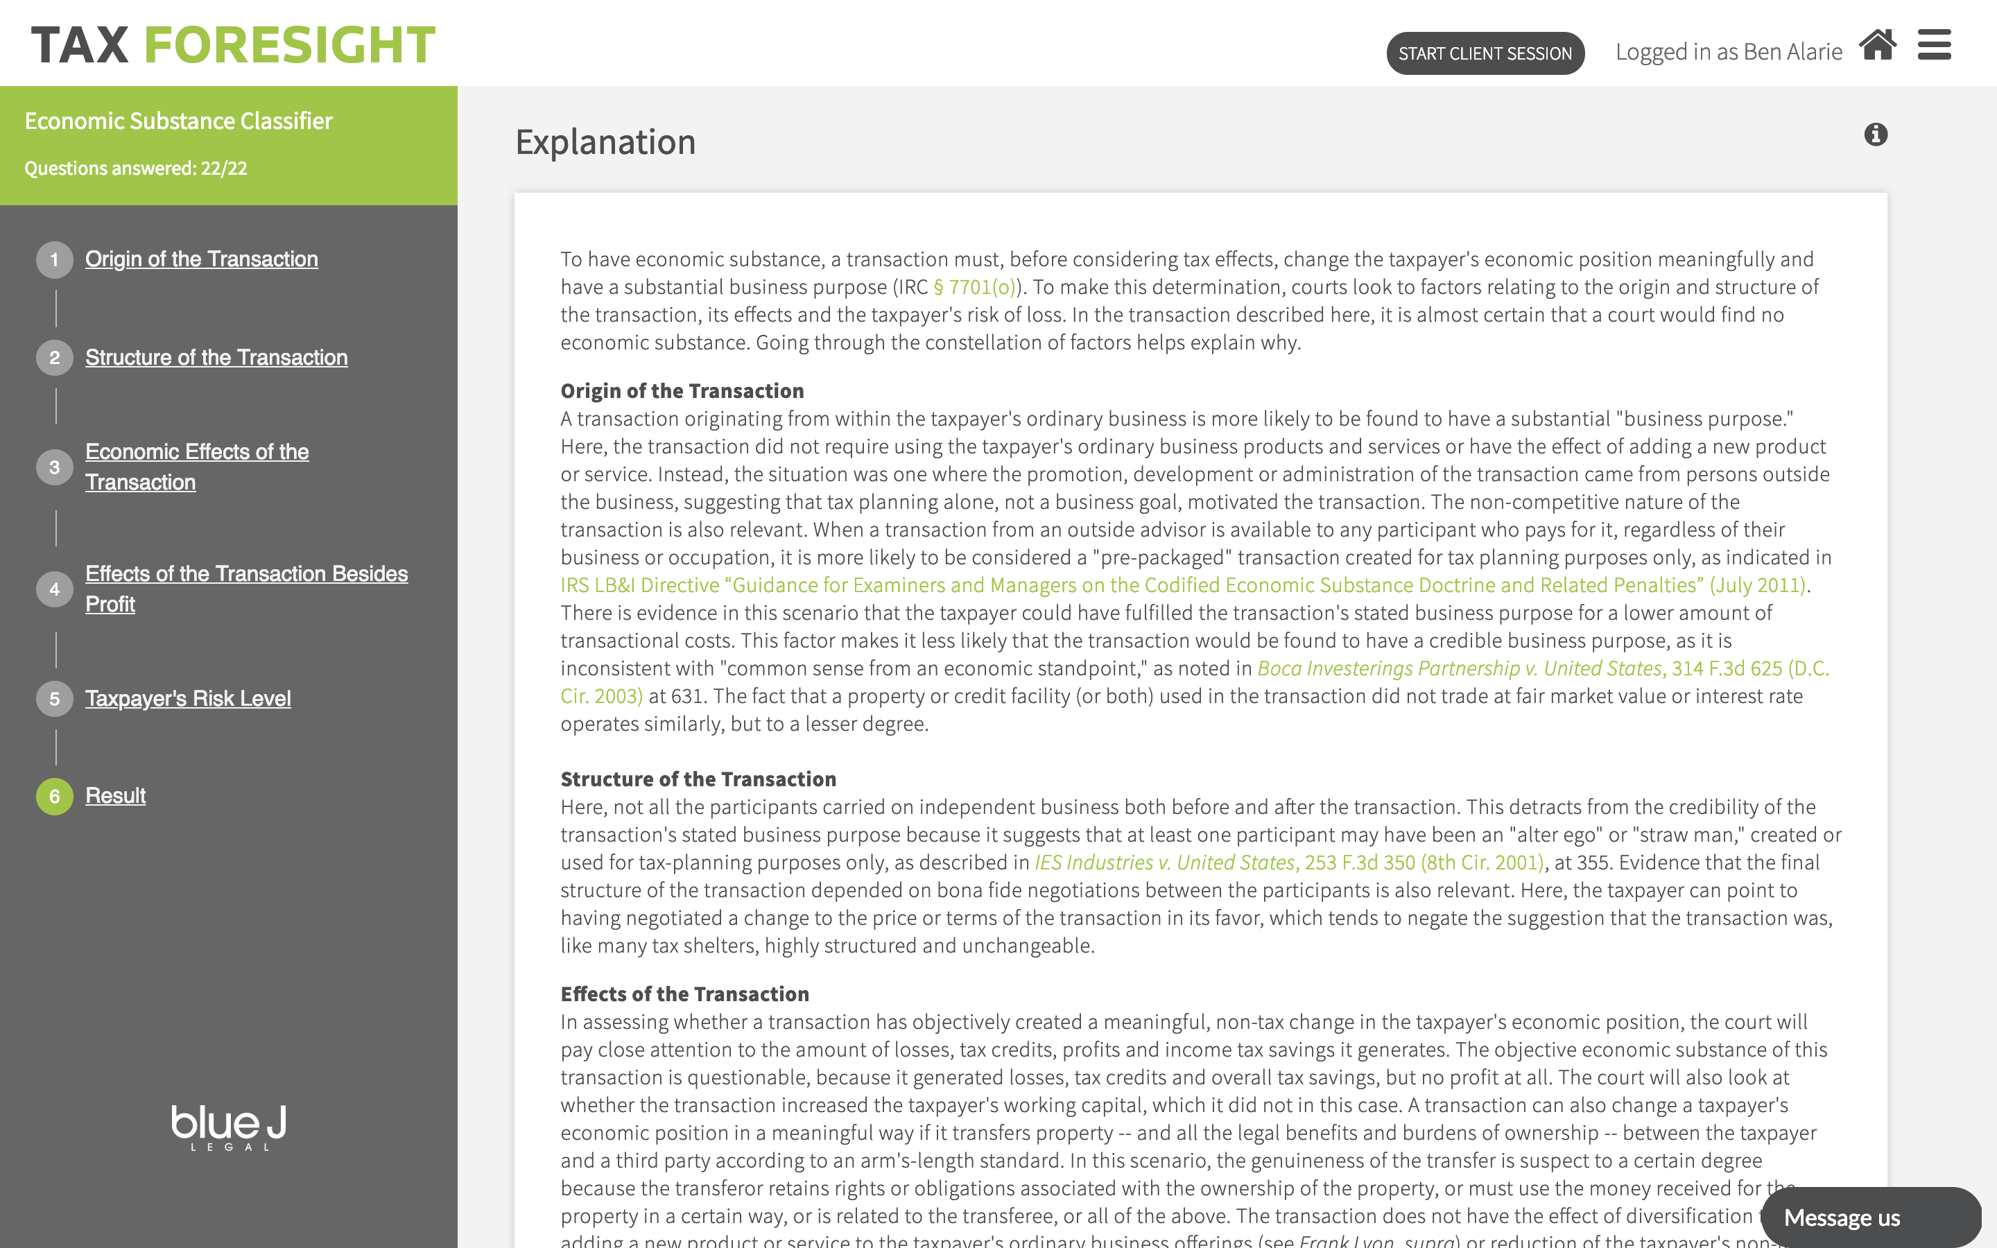

Slide 10
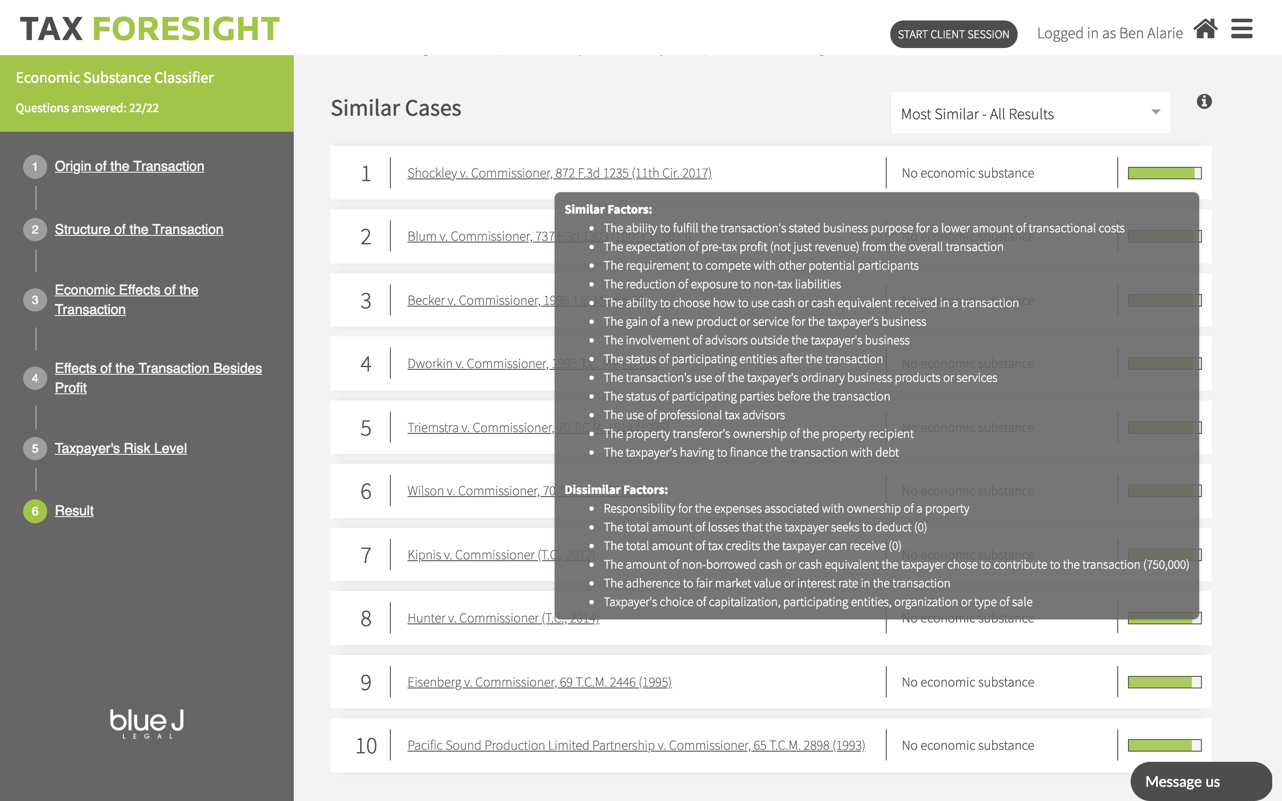

Slide 11
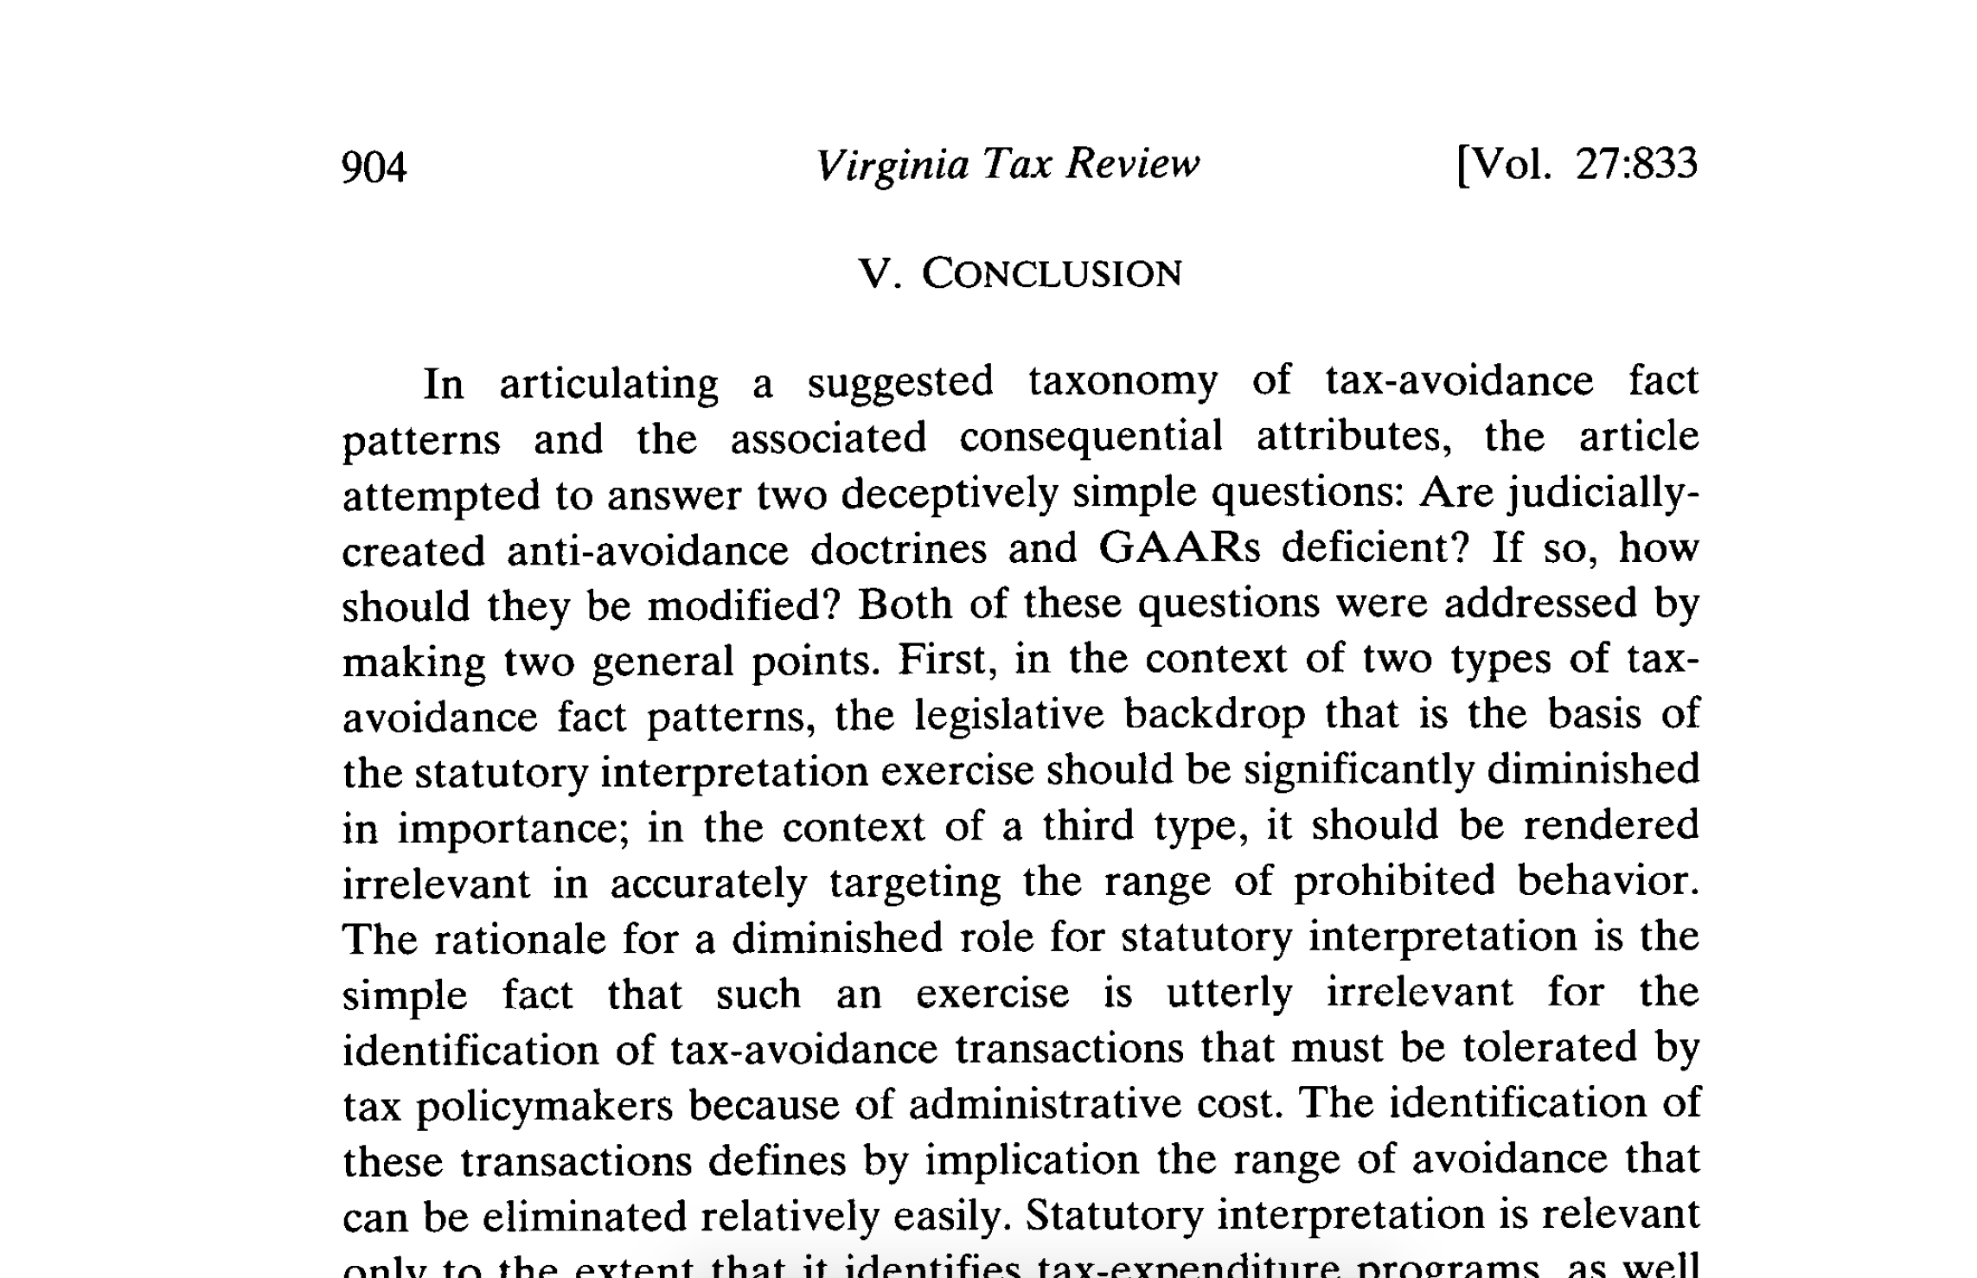
“The suggested refinements of a GAAR attempt to provide a legislative means to identify (relatively easily) the range of problematic tax-avoidance transactions …. The principal role of the judiciary would be the proper characterization of the fact pattern presented by a particular transaction, with the appropriate policy result following from this characterization.” — Tim Edgar Building a Better GAAR (2008)

